Slide 1
AMAZON WEB SERVICE (AWS)

Slide 2
WEB Fundamentals
REQUEST
Client uses network to route packets/data to server
Network
Server
(hosted
somewhere)
Client
(browser)
Server sends response based on clients IP address
Unique IP
Unique IP
RESPONSE

Slide 3
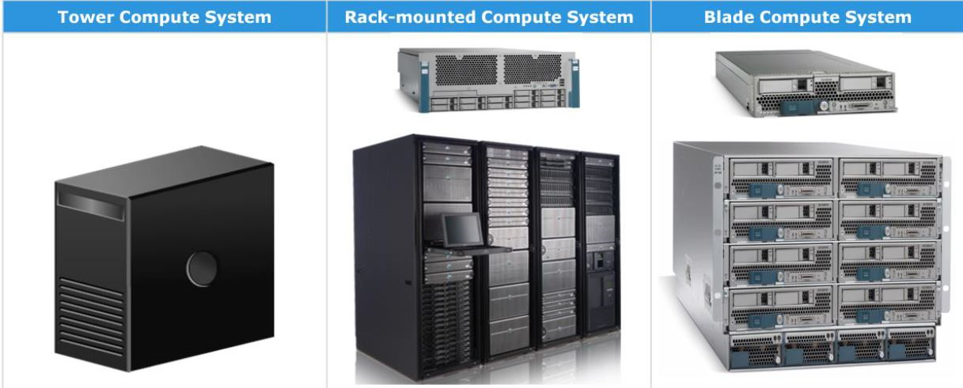
Server
A server receives and responds to requests made by a client over the network.
Server is a specific hardware but a computer can act as server with right software.
Server has CPU, RAM, Storage, Database, Networking Components and OS.

Slide 4
Traditional it
BUILDING/DATACENTER
SERVER
Networking
AC * 2
Server Cost
Maintenance/management cost
Employee Salary
Networking Cost
Constant power supply
Cooling mechanism
Building/space rental cost
Limited Scaling
Web
DNS
Mail
DB
Application
Back
up
Power
24 * 7
Backup Power
Notes:
A data center or data center is a building, a dedicated space within a building, or a group of buildings used to house computer systems and associated components, such as telecommunications and storage systems. (Wikipedia)

Slide 5
Cloud computing
On demand delivery of computing power, storage, database, application and IT resources via a cloud service platform.
Pay as you go pricing.
Customizable resources of the correct types and combinations based on needs.
Instant access to resources & easy to monitor and access via cloud interface.
Example: Gmail, Dropbox, Google Drive, Netflix (based on AWS)

Slide 6
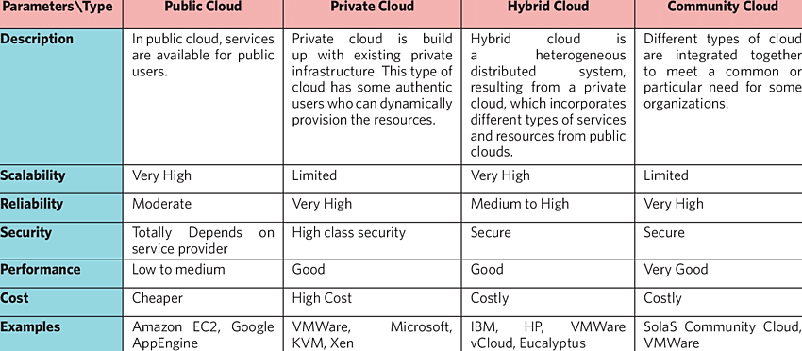
Cloud types
Notes:
https://www.researchgate.net/profile/Amitava-Nag/publication/270958592/figure/tbl1/AS:667666268319773@1536195451769/Comparison-among-Public-Private-Hybrid-and-Community-Cloud.png

Slide 7
Cloud characteristics
On demand
User can select/choose resources without intervene of cloud service providers.
Access to reliable and broad network.
Elasticity, privacy, security and scalability.
Pay as you go. Only pay for the services and time period that we’ve used
Notes:
Cloud Elasticity is the property of a cloud to grow or shrink capacity for CPU, memory, and storage resources to adapt to the changing demands of an organization.

Slide 8
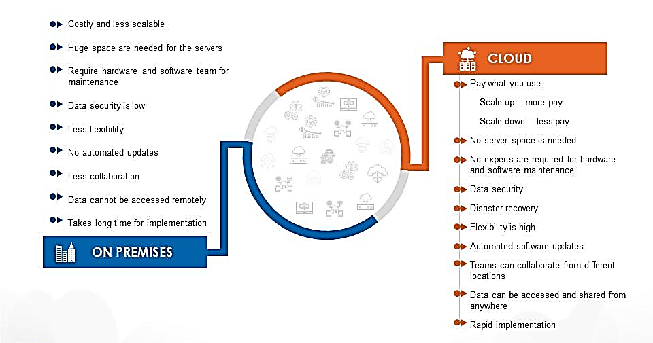
Traditional vs cloud
Notes:
https://www.slideteam.net/cloud-vs-traditional-datacenters-cloud-computing-ppt-diagrams.html

Slide 9
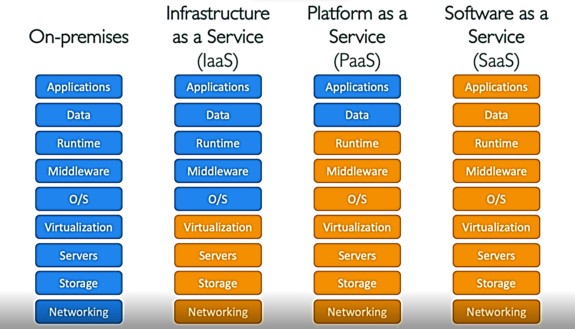
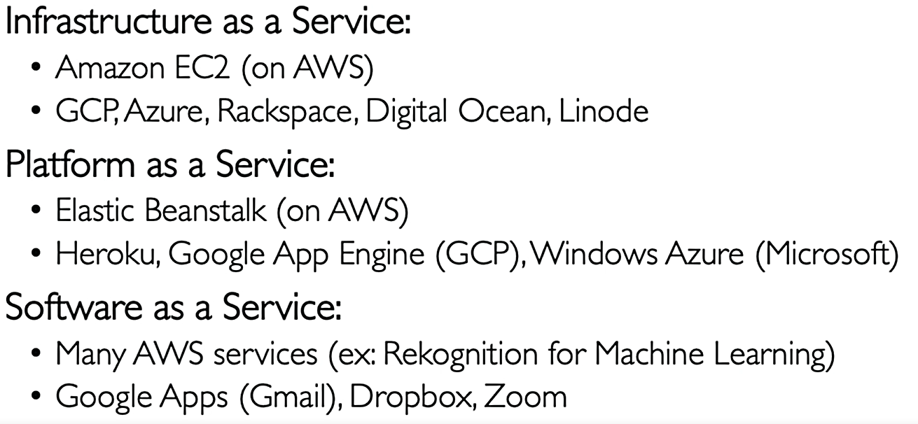
cloud service types

Slide 10
pricing
Computation:
Pay only for the total times that we’ve used for computation process.
Storage:
Pay only for the exact amount of data we’ve stored
Networking:
Pay for only for data that leaves the cloud. Any data going into the cloud is free.

Slide 11
Iam Service
Identity & Access Management (IAM) is a global service
In IAM, we create users and assigns them to groups.
Root user is created by default when account is created.
It is recommended to use root account only for account settings and nothing else nor share.
Instead of root, use/create new users and assign them to groups.

Slide 12
IAM groups & users - 1
Groups contains users only
Group cannot contain another group
A user can exist without a group, also can be a part of multiple group
Dev 1
Dev 2
Ops 1
Ops 2
User 1
Dev 3
DevOps
User 1
Ops 3
Group: (NONE)
Group: Development
Group: Operation

Slide 13
IAM groups & users - 2
We create users and groups so that users can access AWS account.
Users and groups needs to be given permissions in order to access AWS
IAM policy is a json document where we assign users and groups.
Through IAM policy we allow users to use different AWS services.
Least Privilege Principle indicates do give more permissions than a user needs.

